Slide 1
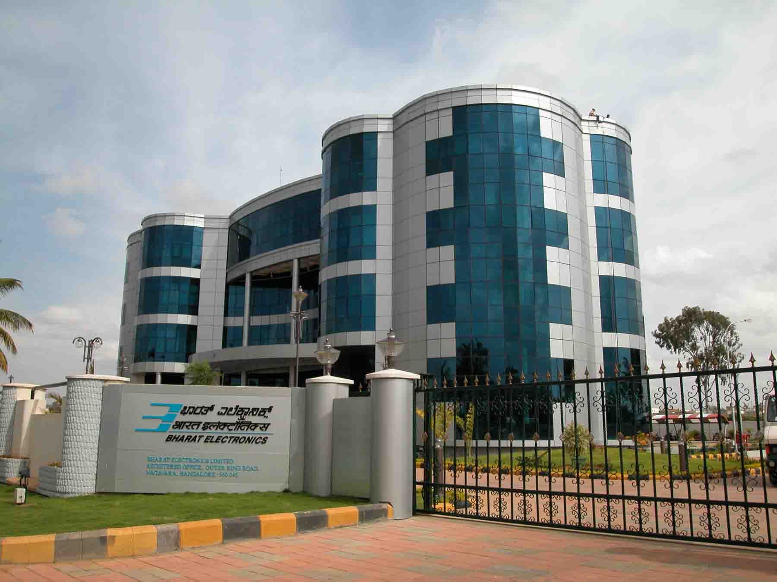
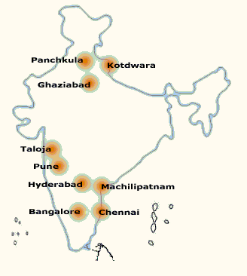
Bharat Electronics
www.bel-india.in

Slide 2
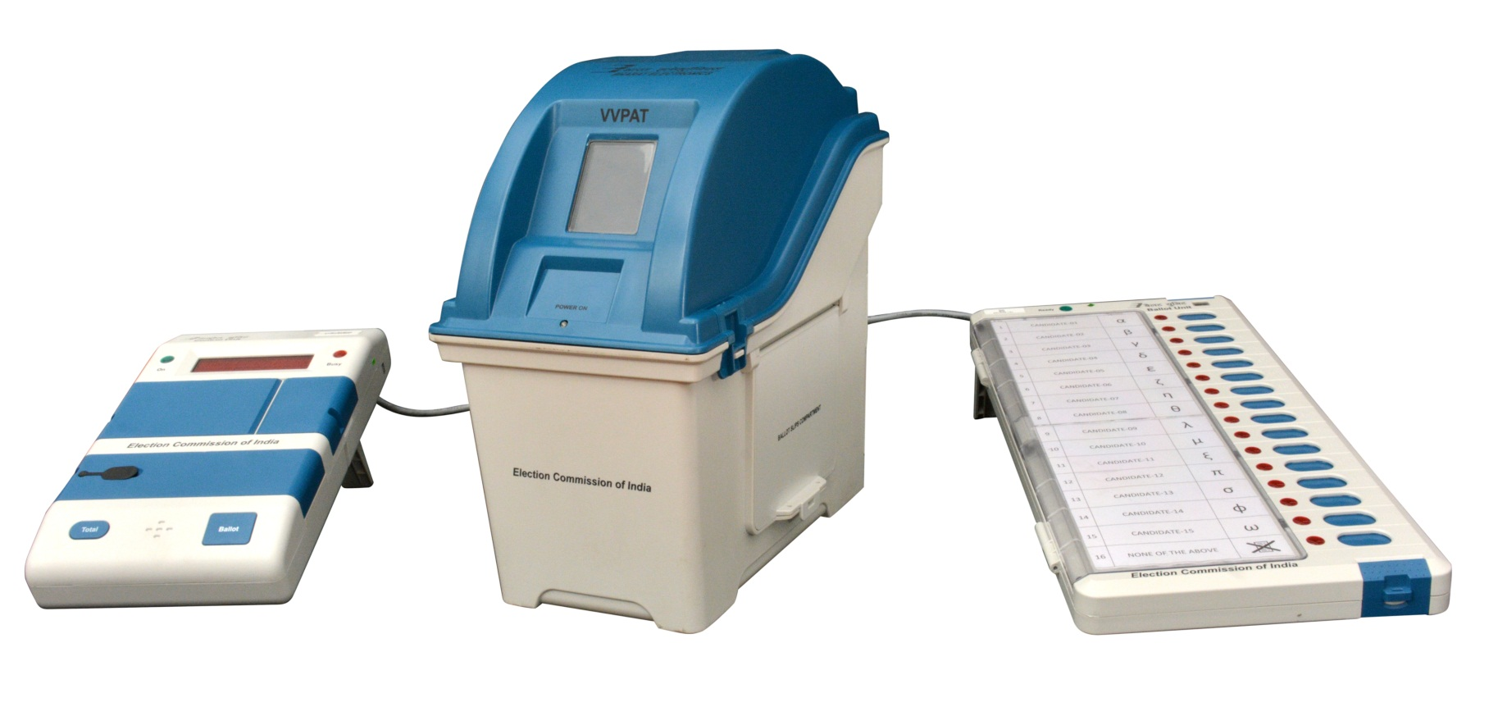
VVPAT
Commissioning of
VVPAT

Slide 3
VVPAT
Preparation (Commissioning) of VVPAT by Returning Officers (RO)

Slide 4
VVPAT – Loading of original Symbols
Loading of Originals Symbols shall be done by BEL/ECIL Engineers
After getting final list of candidates from RO, Create VVPAT sheet with help of Symbol loading application in PC/Laptop.
Take print of loaded Symbols and Get Approval from
Returning Officer (RO).
In case of any modification, Edit created VVPAT Sheet.
After final Approval, load symbols into Symbol Loading
Unit (SLU) for load in all VVPATs.

Slide 5
VVPAT Preparation
Insert New battery pack into Battery Compartment.
Insert New Paper Roll into paper Compartment.
Seal the Paper Compartment through side latches.
Connect VVPAT with Symbol Loading Unit (SLU)
with VVPAT Cable.
Load symbols from SLU to VVPAT.
Check all Self-diagnostic Slips.
Connect VVPAT with CU and BU and perform
Mock-poll as per given instruction.
Disconnect connections after that and store VVPAT
in respective carrying case..

Slide 6
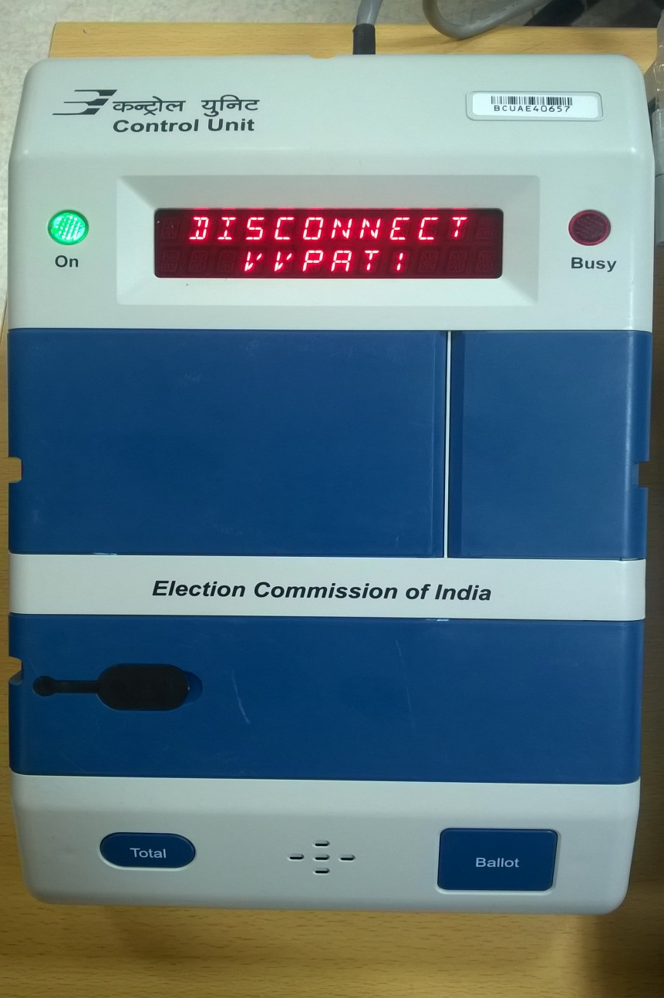
VVPAT Preparation
During preparation of EVM, While
Candidate set in CU, VVPAT
should be connected with EVM,
Else “Disconnect VVPAT” message
will be flash on CU after pressing
of “ Ballot” button.
Connect VVPAT with CU and BU
and perform Mock-poll as per
given instruction.
Disconnect connections after that
and store VVPAT in respective
carrying case..

Slide 7
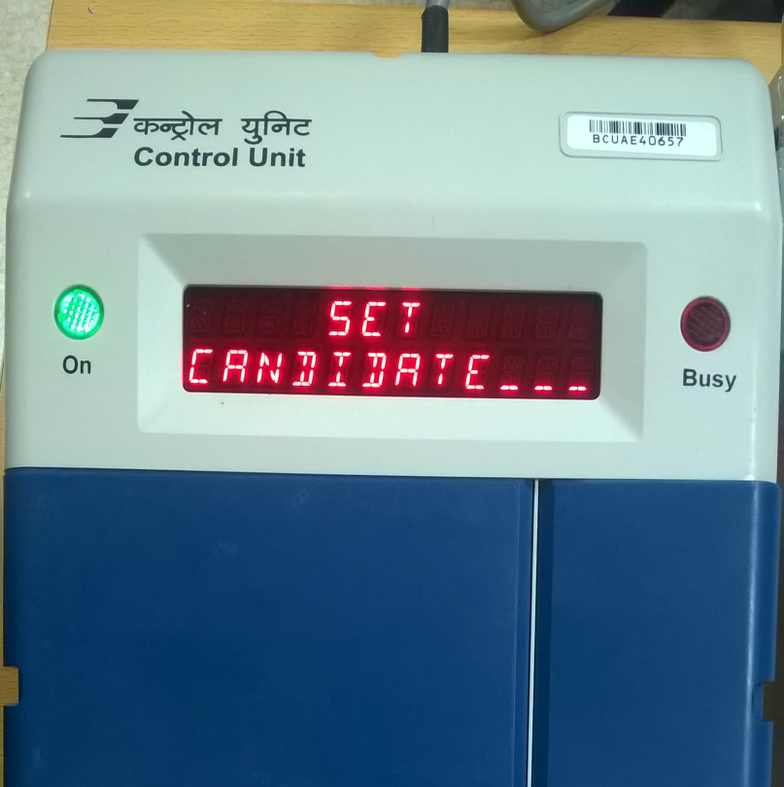
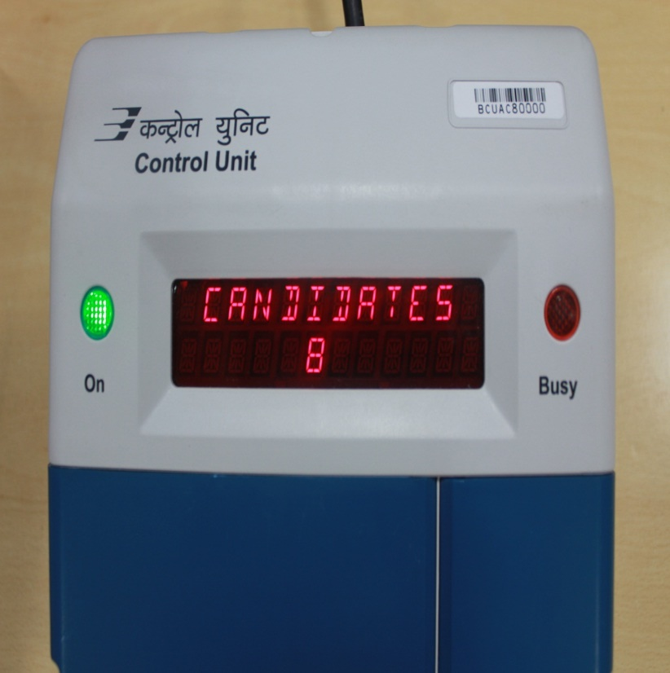
VVPAT and EVM – Candidates Setting
Connect VVPAT with Control Unit and Ballot Unit. Press “ Cand Set” Button on CU. Press the respective button in BU. For example, if you press 8th button in CU, will be flashed on CU.
CANDIDATES
8

Slide 8
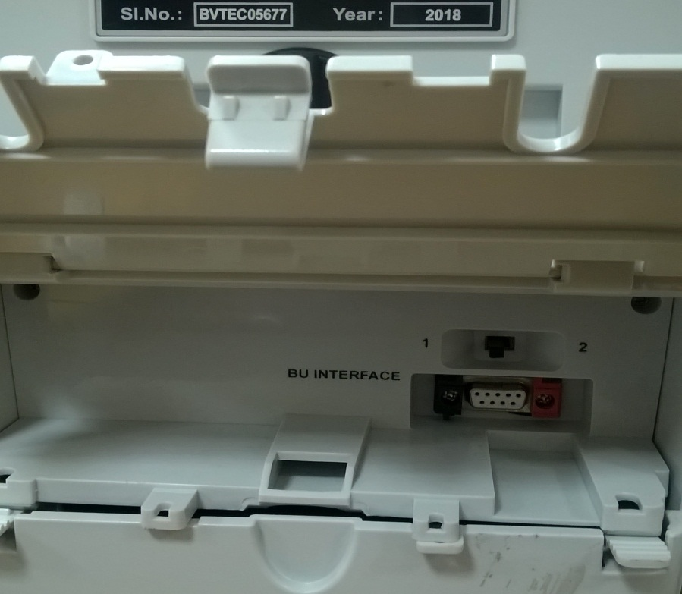
VVPAT cascading with Ballot Unit
In case Two VVPATs are being used….
Connect the Second VVPAT to the Ballot Unit by connecting the VVPAT Cable to the rear side of Ballot Unit as per instruction given by RO .
VVPAT selection position of second VVPAT
should be on 2 (Right Side).
Position of second VVPAT Switch in 2.

Slide 9
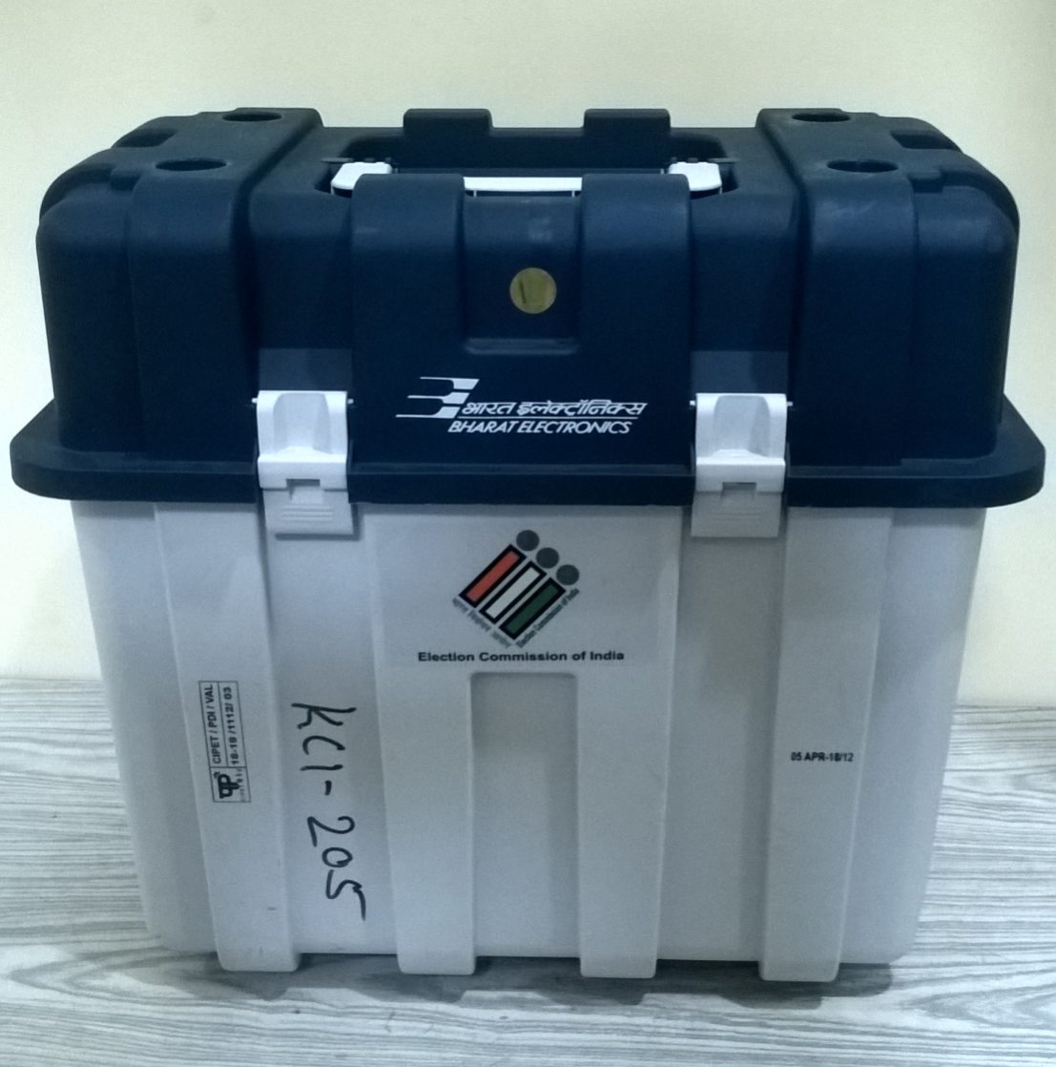
VVPAT
Packing after preparation
Set the ‘knob’ at the back to sleep mode so that paper roll does not move.
Pack the prepared VVPAT in Carrying cases
Thank You

Slide 10
Gist of activities on VVPAT
Loading of candidates by ECIL engineers ( to be certified by RO/ARO)
Setting of power pack
Setting of paper roll
Fixing of address tags ( 3 nos),
Setting Knob at the back ( horizontal position)

Slide 11
MOCK POLL OF VVPAT
After Candidate setting one mock poll in B.U button including NOTA
VVPAT slips stamped at their back side with rubber stamp- TESTING VVPAT SLIP – VVPAT COMMISSIONG
Collect and store VVPAT Slip in RED colour envelop SEALED with seal of RO
1000 MOCK POLL Slip Stamped at their back side with rubber stamp- MOCK POLL SLIP – EVM COMMISSIONG should be kept in GREEN COLOUR envelope SEALED with seal of RO

Slide 12
(Register for Preparation of EVMs)
ANNEXURE-15
Name of State /UT :
Name of District :
Name of Assembly/ Parliamentary Constituency :
Address of Preparation of EVM hall :
Date :
Sl No | Name of Candidate | Name of Representative of candidates with party affiliation , if any | Identity document No. with date | Signature of Candidates/His representative | Remarks, if any.
Note : If a candidate or his representative is absent the proof of due service of notice to the candidate should be pasted in the register.
(Name and signature of engineers of BEL/ECIL with ID No.)
(Name, designation, signature of officers nominated by District Election Officer)

Slide 13
ANNEXURE-17
INSTALLATION OF PAPER ROLL IN VVPAT
Open the Paper Roll compartment by opening the side latches and by lifting the top cover. Observe the Paper Roll Compartment which holds the Paper roll.
Remove “Spindle” from its position by pulling towards upward direction.
Insert “Spindle” into “Thermal Paper Roll”
Place the “Thermal Paper Roll” with “Spindle” into its position (i.e. Paper Roll compartment) and press it towards down.
Insert “Thermal Paper Roll” edge into the “Guide-Paper Entry”. Ensure that the plain paper should be on the top surface and the printed band should be on the lower Surface of the Paper.
Move the paper into the slot by rotating the paper feed knob clockwise.

Slide 14
(Mock Poll certificate during Preparation of EVMs)
ANNEXURE-18
Name of State /UT : Date :………………
Name of District :
Name of Assembly/ Parliamentary Constituency :
Address of hall :
It is certified that during commissioning of EVMs and VVPATs, mock poll of 1000 votes have been cast on 5% randomly selected EVMs, as well as VVPATs. The electronic result tallied with paper count, picked up by me. There are no discrepancies between the votes polled during the mock poll.
Sl No | Name of Candidate | Name of Representative of candidates with party affiliation , if any | Identity document No. with date | Signature of Candidates/His representative | Remarks, if any.

Slide 15
